Slide 1

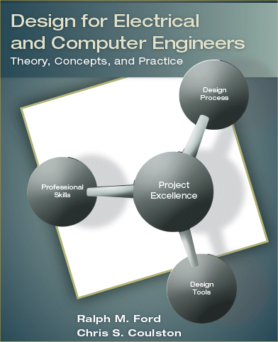

Slide 2


Copyright 2005
Ralph M. Ford and Chris Coulston
Design for Electrical and Computer Engineers (Published by McGraw Hill)
Not to be transmitted or reproduced without written consent of authors

Slide 3

By the end of this chapter, you should:
Have an understanding of the types of projects electrical and computer engineers undertake.
Understand and be able to apply sound criteria for project selection.
Know how to determine, document, and rank end-user needs.
Be aware of resources for conducting research surveys.
Have selected a project concept and developed a problem statement.

Slide 4

Creative Design
Variant Design
Routine Design

Slide 5

Systems Engineering & Integration
  Large-scale, many people
Testing.
  Does system meet requirements?
Experimental Design
  Design experiment or apparatus
Analysis
  Correct problem, i.e. FMEA

Slide 6

Discover or create something new.
Technology evaluation.
Applied Research.
Fundamental Research

Slide 7

Industry sponsorship
Engineers without Borders
www.FreeRandD.com
Campus and local community
Brainstorming

Slide 8
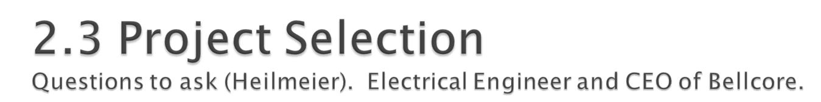
What are your trying to do? Articulate your goals using absolutely no jargon.
How is it done today, and what are the limitations of current practice?
What is new in your approach, and why do you think it will be successful?
Who cares? If you are successful, what difference will it make?
What are the risks and payoffs?
How much will it cost? How long will it take?
What are the midterm and final exams' to check for success?

Slide 9

See Appendix B – Complete description of AHP
Determine selection criteria
Determine the criteria weightings
Identify and rate alternatives relative to criteria
Compute scores
Review the decision

Slide 10

Gather raw data.
Translate to marketing requirements.
Organize the needs into a hierarchy.
Rank the Needs
Review the outcomes

Slide 11

“Design a mechanical arm to pick apples from a tree.”
Is this a good problem statement?
What is a better one?

Slide 12

Copyright 2005
Ralph M. Ford and Chris Coulston
Design for Electrical and Computer Engineers
Not to be transmitted or reproduced without written consent of authors

Slide 13

The traffic at the front of campus is too congested. I would like you to design a new traffic lane for the northbound traffic exiting at the intersection at the front of the college.
Is this a good problem statement?
What is a better one?

Slide 14

Copyright 2005
Ralph M. Ford and Chris Coulston
Design for Electrical and Computer Engineers
Not to be transmitted or reproduced without written consent of authors

Slide 15

Some methods are:
Interviews (see questions in the book).
Focus Groups
Observation – i.e IDEO shopping cart & heart device
See questions in book
Technology push-pull
Trends

Slide 16

Marketing Requirements
Statement of Customer Needs in language of customer.
What the product should do, NOT how it should be achieved.
Short, action-oriented phrases
Example - “The system should have high quality audio.”

Slide 17
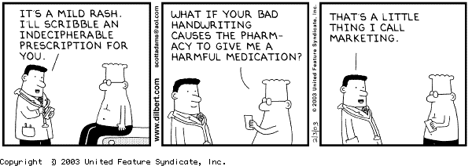
Copyright 2005
Ralph M. Ford and Chris Coulston
Design for Electrical and Computer Engineers
Not to be transmitted or reproduced without written consent of authors

Slide 18

Example
In IDEO Video, the guy said, “these carts have been clocked going 35 mph”, what is the marketing requirement that goes with this statement?
Answer(s):
Cart should not move in wind.
Cart should not exceed XX mph.

Slide 19
Example
Customer says: “The current system is bulky and hard to hold”. The marketing requirement for this is?
Answer - “The system should be easy to hold with hand”
Example
Customer says “The system should be safe.”
Answer – “The system should be safe.”
Copyright 2005
Ralph M. Ford and Chris Coulston
Design for Electrical and Computer Engineers
Not to be transmitted or reproduced without written consent of authors

Slide 20

Organize needs by functional similarity, not by importance!
What is functional similarity?

Slide 21

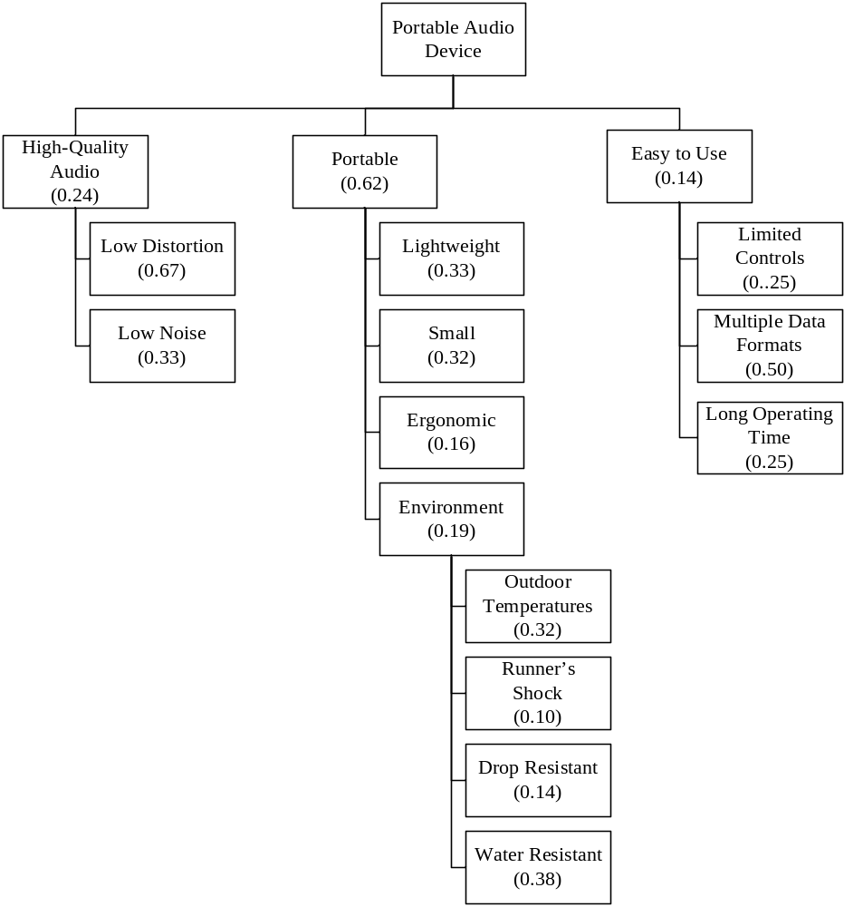

Slide 22

Rank the needs to determine the relative importance of each of the needs.
Systematically compare each need to all other needs.
Who should do this?

Slide 23
 | High-Quality Audio | Portable | Easy-to-Use | Score
High-Quality Audio
Portable
Easy-to-Use

Slide 24

This is just a process that embodies a good practice.
It is ultimately for making decisions about what is important to the end-user.
In the end ask yourself – “Does this make sense?” If not, you should make it so that it does or determine why not.

Slide 25

Gather Raw Data (Customers, end-users)
Translate into Marketing Requirements.
Organize need into Hierarchy (Functional Similarity)
Rank Needs (Pairwise comparison – at each level)
Review the outcomes
YES – you will apply this to your design project!

Slide 26

You need to become the experts on the problem and state-of-the-art in this area.
If you don’t, then you re-invent the wheel
If you don’t, then you don’t look too smart.

Slide 27

What is the basic theory behind the concept?
How is it currently being done?
What are the limitations of the current designs or technology?
What are the similarities/differences between your concept and current systems?
Are there existing or patented systems that are relevant to the design?

Slide 28

See the book
  Internet resources
  Electrical and computer engineering type.
  Government resources
  Journal and conference papers.

Slide 29

The need statement should
Briefly and clearly state the need to be met
Do not provide a solution to the problem
Provide supporting statistics or anecdotes
Describe current limitations
Describe any supporting processes.

Slide 30

According to AppleInsider, approximately 10.3 million people owned iPods at the end of 2004 and many of the owners used them while operating their automobiles. The National Highway Traffic Safety Administration estimates that driver distraction is a contributing cause of 20 to 30 percent of all motor vehicle crashes – or 1.2 million accidents per year. One research study has estimated that driver inattention may cause as many as 10,000 deaths each year and approximately $40 billion in damages. iPods can present a distraction to drivers that is similar to cell phones in that the driver’s attention is divided between controlling the steering wheel, watching the road, and navigating controls on the iPod. A system is needed to allow users to navigate among the music selections of their iPod without distracting their attention from the road.
From the iPod Hands-Free Device Design Report by Al-Busaidi, Bellavia, and Roseborough [Alb07].

Slide 31

The objective statement should
Summarize what is being proposed to meet the need
Provide some preliminary design objectives
Provide a preliminary description of the technical solution, avoiding a detailed description of the implementation.

Slide 32

The objective of this project is to design and prototype a device that will make the iPod safer to use while driving an automobile, by allowing hands-free control of the iPod. The device will interact with the user using spoken English commands. The user will be able to issue simple voice commands to the device to control the operation of the iPod. In turn, the device will communicate information verbally, such as song titles that are displayed on the iPod screen, to the user.
From the iPod Hands-Free Device Design Report by Al-Busaidi, Bellavia, and Roseborough [Alb07].

Slide 33

Problem Statement Contents
Need
Objective
Background (Research Survey)
Marketing Requirements
Objective Tree

Slide 34

Apply sound project selection criteria.
Determine the true user needs.
Outcomes of the needs elicitation process.
  Marketing requirements
  Objective Tree
  Ranking of the needs
Conduct research survey
Problem Statement
  Needs
  Objectives

